Slide 1

Treasure HUNT
MSACS Spring 2020 GDP-II Group - 6

Slide 2

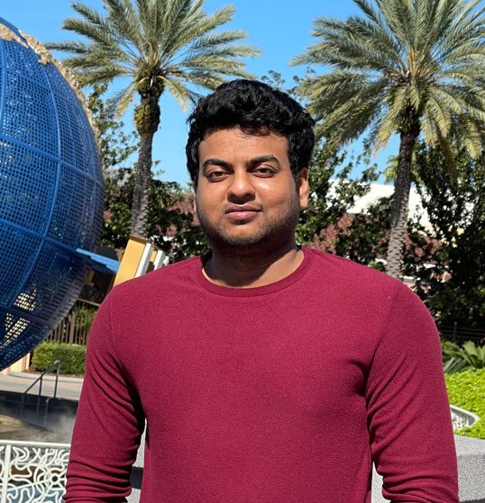
Team Members
Swaroop Reddy Gottigundala
s538342
Krishna Sumanth Koyyalamudi
s538345
https://github.com/Krishna-Koyyalamudi
https://github.com/SwaroopReddyGottigundala

Slide 3
Spring Boot Application
Client Name : Case Consulting, Mobile Game Division
Mentor Name : Dr. Denise Case
GitHub Repository link : https://github.com/Krishna-Koyyalamudi/group-6-full-stack-app
Hosted Application on Heroku : https://hunt6.herokuapp.com/
The requirement was to develop an application which would resemble a treasure hunt/ scavenger hunt.
Like treasure hunt, the user/creator can add a location data along with its geographical co-ordinates.
Then a regular user should be able to play the game using a mobile or a handheld device.
A random location must be fetched for the user from the list of locations available in the application when the user clicks 1st element, and the application should be able to detect the user location and determine whether the person has found the location while he/she moves around and clicks the 2nd element.

Slide 4

Stack Details
Platform: Java
Framework : Spring
User Interface : HTML, CSS, JS, Bootstrap and Thymeleaf
ORM : Hibernate
Database : MySQL (local), PostgreSQL (server)
API : geolocation
Build : Maven
Hosting service : Heroku

Slide 5
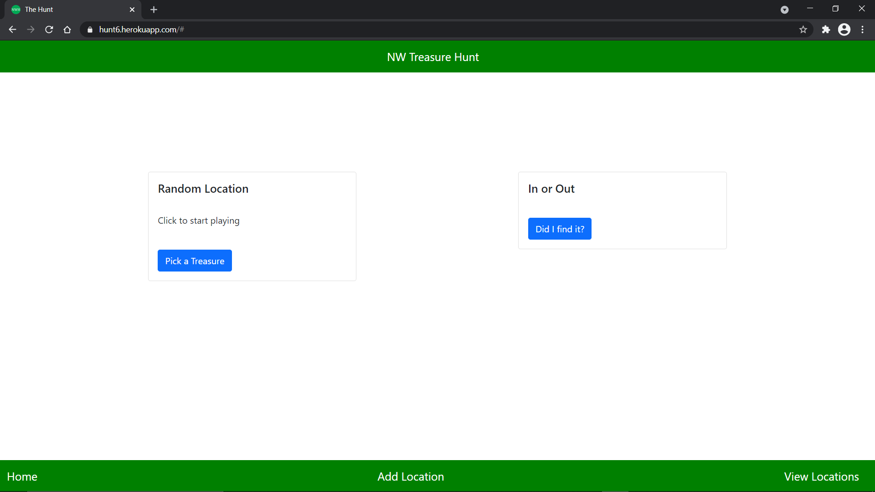
Application Home
The Home Page consists of two cards with two buttons respectively in each card.
Once the user opens the application, he/she is greeted with the following page.
The User can see the message “Click to start playing” which will also be announced using speech.

Slide 6

Picking a Treasure Location
When the user clicks on the 1st button i.e., ‘Pick a Treasure’, a random location from the list of locations available in the database is fetched.
When the application is ready with a location, it notifies user that “The treasure location has been set. start exploring !”
Now, the user can play the game by moving around.

Slide 7
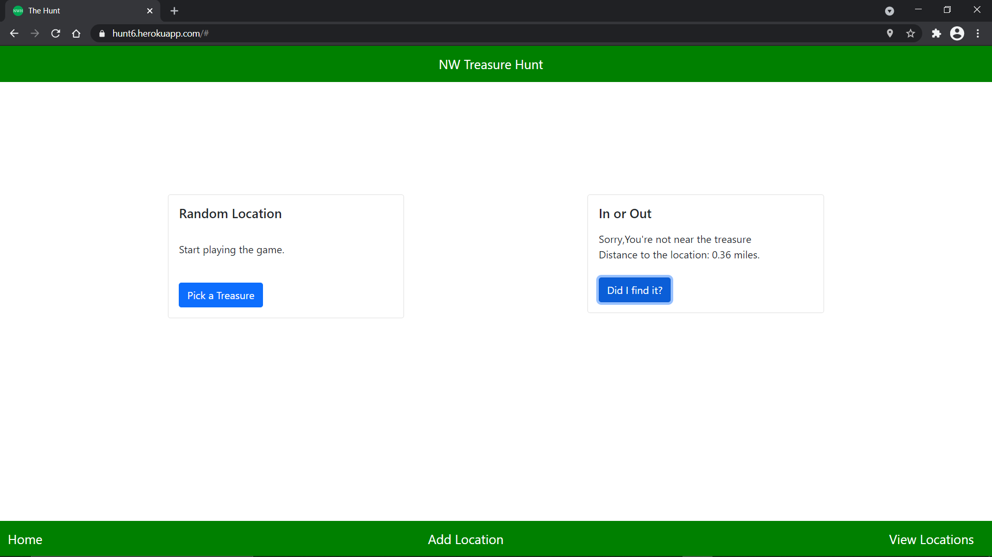
Outside the treasure location
This is screenshot showing the scenario of the user outside the location area.
When the user clicks on the 2nd button, i.e., ‘Did I find it?’ , the application grabs the user’s current location and checks whether the user is in the specified range of the location.
If not, then the application displays the distance between the user and the target location.

Slide 8
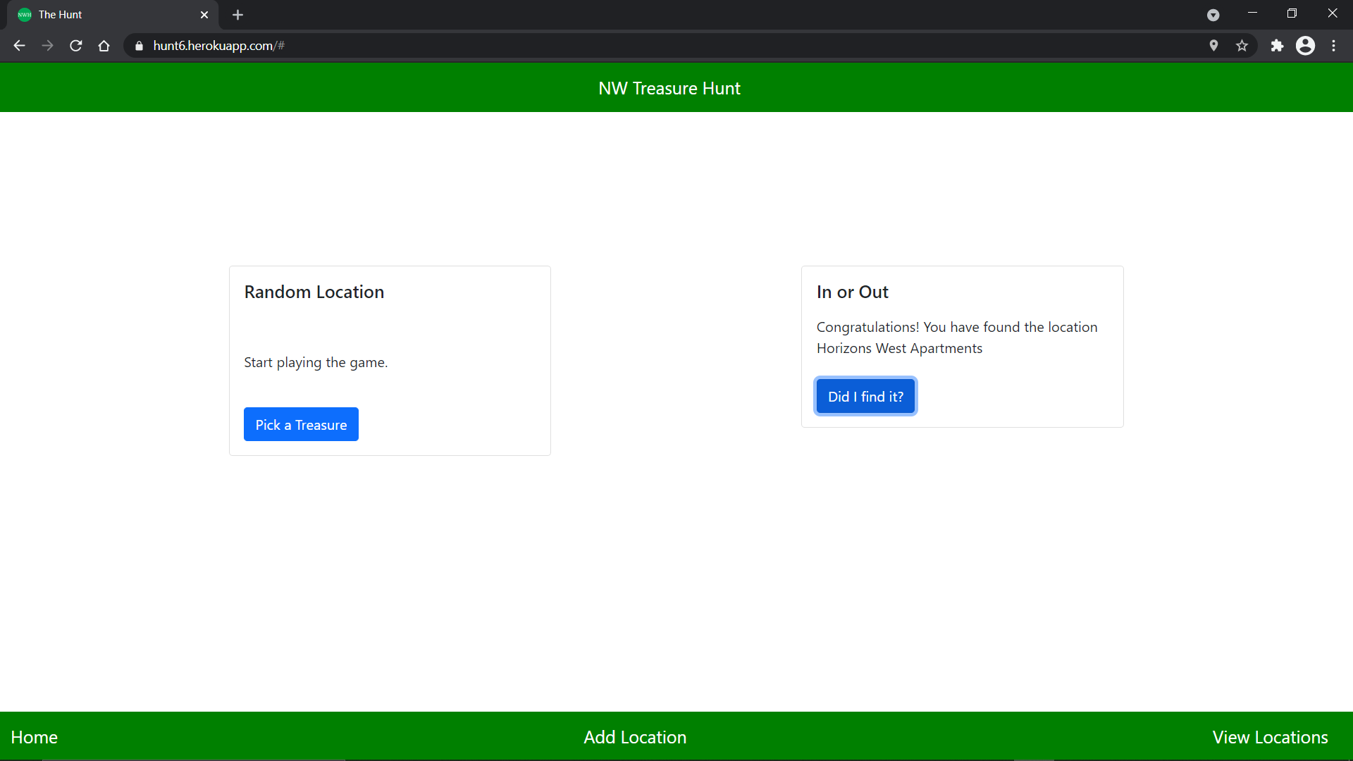
Found the Treasure
If the user has found the treasure location and is inside the range of location, User is greeted with a Congratulations message displaying the location he/she found.
“Congratulations!, You have found the location location-name” and also utters the same as well.

Slide 9
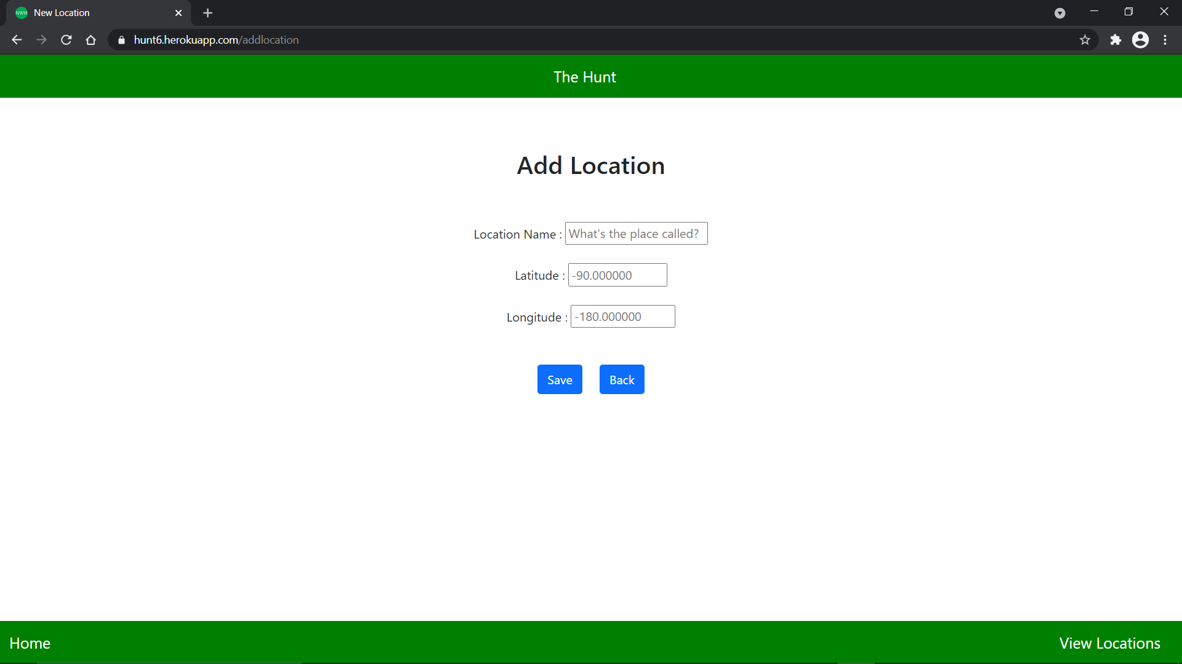
Add new Location
This is page where new locations can be added to the application so that users will be able to play with them.
All the fields are restricted with proper validations. The location name does not accept any special characters.
Latitude only accepts values between the range of -90 to +90
Longitude only accepts values between the range of -180 to +180

Slide 10
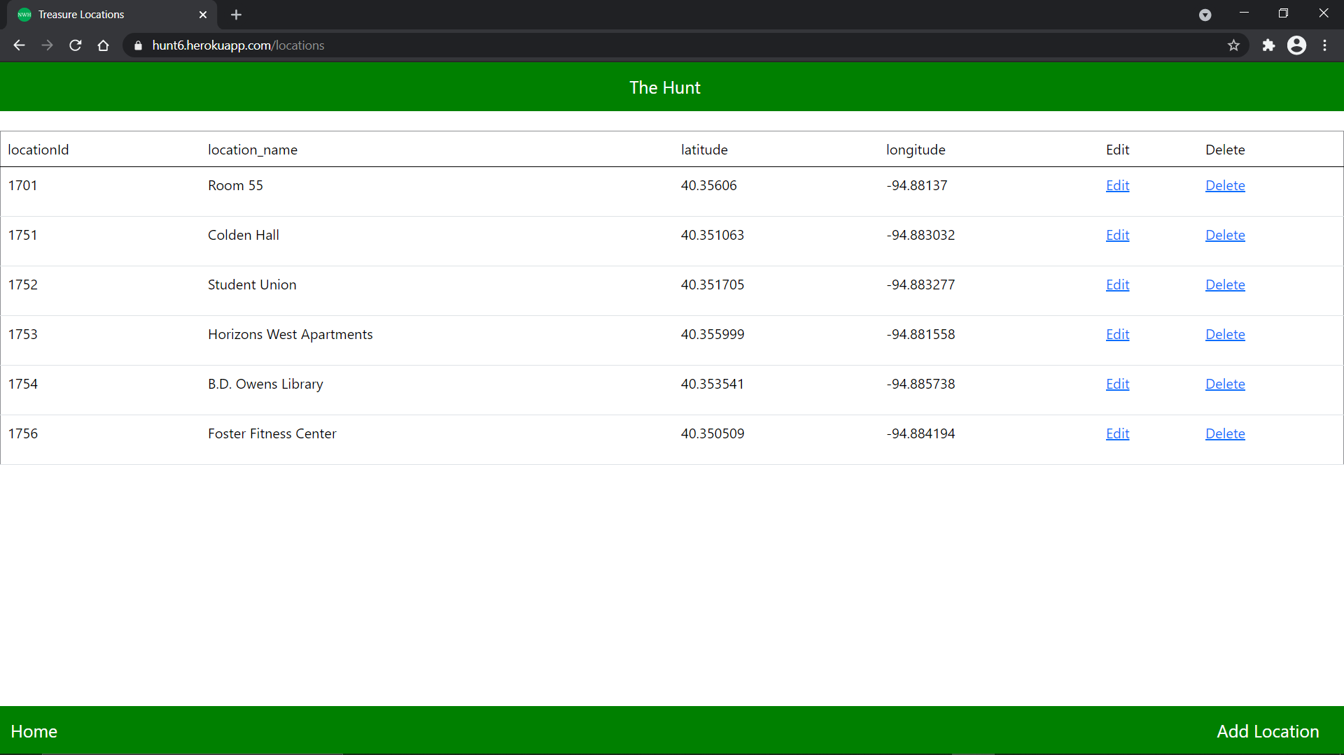
View Locations
In this page we can take a look at all the locations available in the database.
We can either update or delete a location by clicking on the respective buttons.

Slide 11
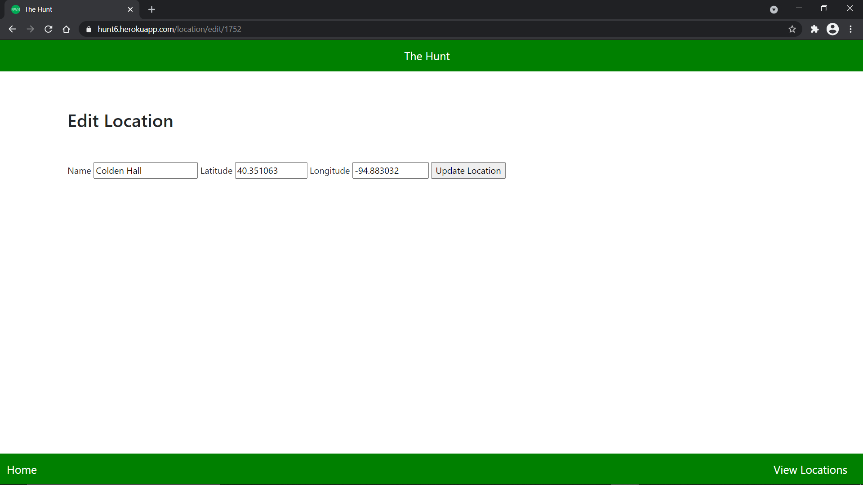
Update Location
When we choose to update a location details, the following page is displayed with the existing data. we can make changes and save it.

Slide 12
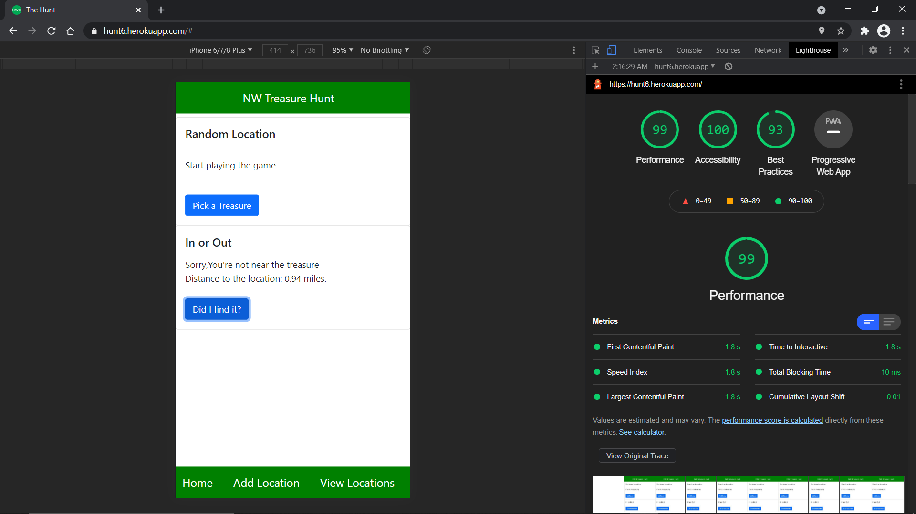
Light House Audit
We have put our application to the Light House Audit available in the Web Browser.
A screenshot of the results is added here for reference.

Slide 13

Thank you

